Slide 1
JK FF and Counter

Slide 2
JK flip flop
The JK flip-flop is the most versatile of the basic flip flops. A JK flip-flop is used in clocked sequential logic circuits to store one bit of data.
It is almost identical in function to an SR flip flop. The only difference is eliminating the undefined state where both S and R are 1. Due to this additional clocked input, a JK flip-flop has four possible input combinations, such as "logic 1", "logic 0", "no change" and "toggle".

Slide 3
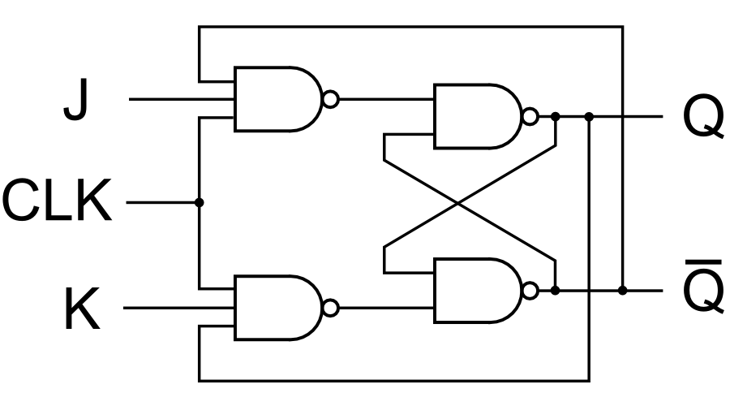
JK Flip Flop
J | K | Q(next)
0 | 0 | Q
0 | 1 | 0
1 | 0 | 1
1 | 1 | Q'(toggle)

Slide 4
J-K Flip-Flop
Here the flip-flop is described using the characteristic table rather than the characteristic equation.
The case multiway branch condition checks the 2-bit number obtained by concatenating the bits of J and K.
The case value ({J,K}) is evaluated and compared with the values in the list of statements that follow.
module jkff(input [1:0] jk,input clk,output q,output qb);
reg q,qb;
always@(posedge clk)
begin
case(jk)
2'b00: q=q;
2'b01: q=0;
2'b10: q=1;
2'b11: q=~q;
endcase
qb=~q;
end
endmodule

Slide 5
//testbench for JK FF
module test;
reg [1:0] jk;
reg clk,i;
wire q,qb;
jkff ob(jk,clk,q,qb);
initial begin
$dumpfile("first.vcd");
$dumpvars(1,test);
$display("time\tclk\tjk1\tjk0\tq\t~q");
$monitor("%0t\t%b\t%b\t%b\t%b\t%b",$time,clk,jk[1],jk[0],q,qb);
jk=2'b00; #10
jk=2'b01; #10
jk=2'b10; #10
jk=2'b11; #10
$finish;
end
initial begin
clk=0;
for(i=0;i<=20;i++)
#5 clk=~clk;
end
endmodule

Slide 6
Counter
An up/down counter is a digital counter which can be set to count either from 0 to MAX_VALUE or MAX_VALUE to 0. The direction of the count(mode) is selected using a single bit input
We can have
Up counter
Down counter
Updown counter

Slide 7
Up counter / down counter
module up_counter(input clk, reset, output[3:0] counter );
reg [3:0] counter_up; // up counter
always @(posedge clk or posedge reset)
begin
if(reset)
counter_up <= 4'd0; // counter_down <= 4‘hf;
else
counter_up <= counter_up + 4'd1;
// counter_down <= counter_down - 4‘f1;
end
assign counter = counter_up;
endmodule

Slide 8
Test-bench
module upcounter_testbench;
reg clk, reset;
wire [3:0] counter;
integer a;
up_counter dut(clk, reset, counter);
initial begin
clk=0;
for( a=0;a<10;a++)
#10 clk = ~clk;
end
initial begin
$display("time\tclk\treset\tcounter");
$monitor("%0t\t%b\t%b\t%b",$time,clk,reset,counter);
reset=1;
#20
reset=0;
end
endmodule

Slide 9
Up_Down_counter
module up_down_counter(input clk, reset,up_down, output[3:0] counter );
reg [3:0] counter_up_down; // down counter
always @(posedge clk or posedge reset)
begin
if(reset)
counter_up_down <= 4‘h0;
else if (~up_down)
counter_up_down <= counter_up_down + 4‘h1; else
counter_up_down <= counter_up_down - 4‘h1;
end
assign counter = counter_up_down;
endmodule

Slide 10
Test-bench
module updowncounter_testbench;
reg clk, reset,up_down;
wire [3:0] counter; integer a;
up_down_counter dut(clk, reset,up_down, counter);
initial begin
clk=0;
for( a=0;a<10;a++)
#10 clk = ~clk;
end
initial begin
$display("time\tclk\treset\tup_down\tcounter");
$monitor("%0t\t%b\t%b\t%b\t%b",$time,clk,reset,up_down,counter);
reset=1;
up_down=0;
#20;
reset=0;
#20; up_down=1;
end
endmodule

